Slide 1
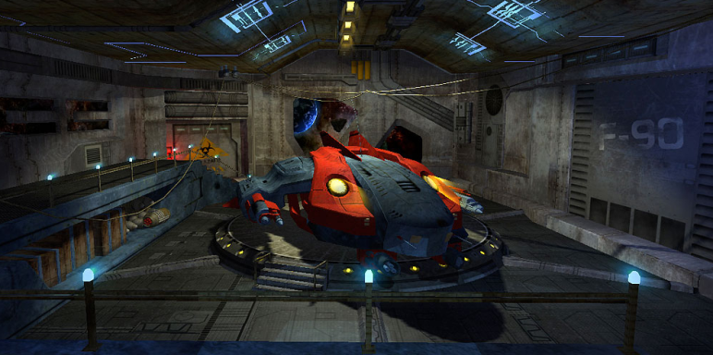
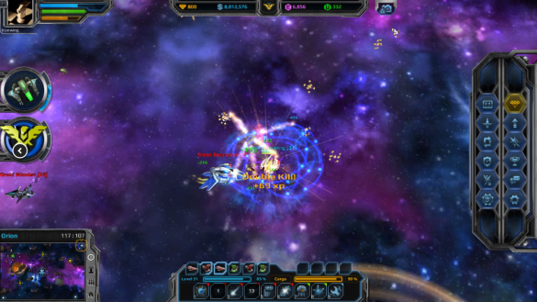

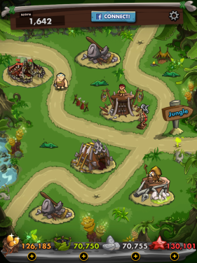

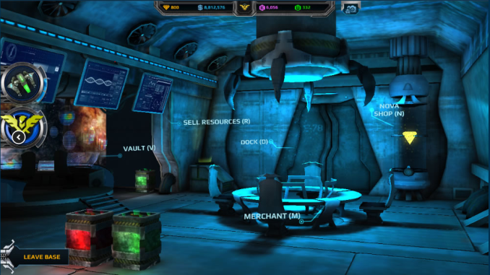


Unity 3D Course
Who are we?
Andromeda 5
Lady Popular
Dino Jack
Twist & Turn

Slide 2

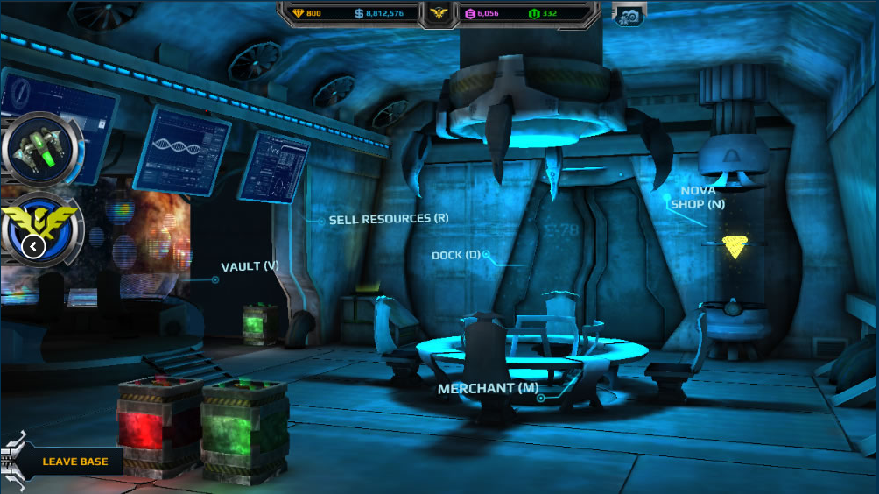

Andromeda 5
Entirely in 3D
Custom UI system based on core unity UI
Client - Server – DB architecture

Slide 3
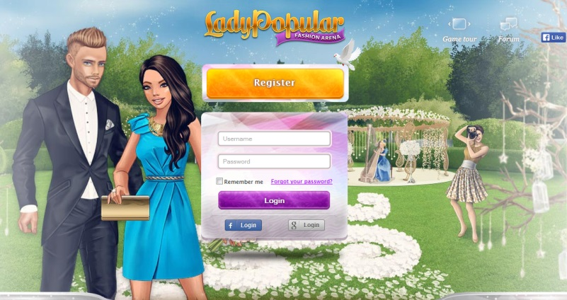
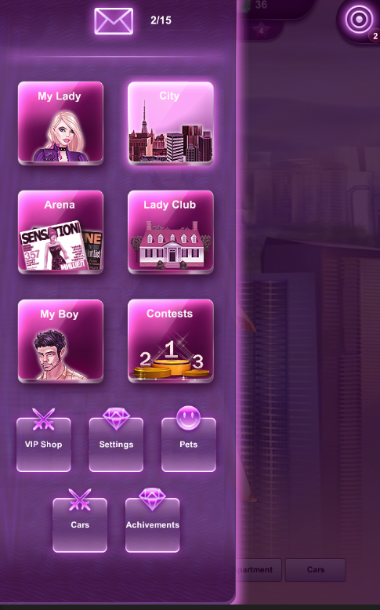
Lady Popular
External GUI System (NGUI)
Client – server

Slide 4


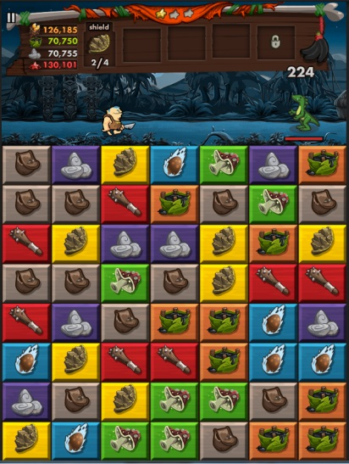
Dino Jack
2D Engine
Hybrid UI
FB plugin

Slide 5
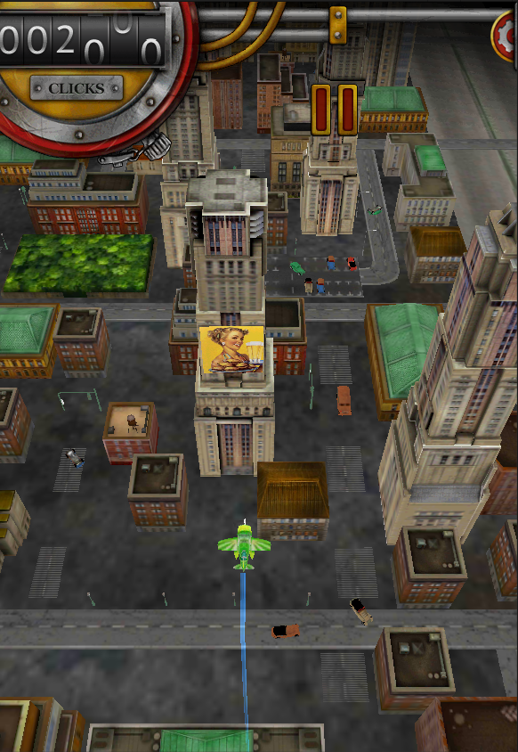
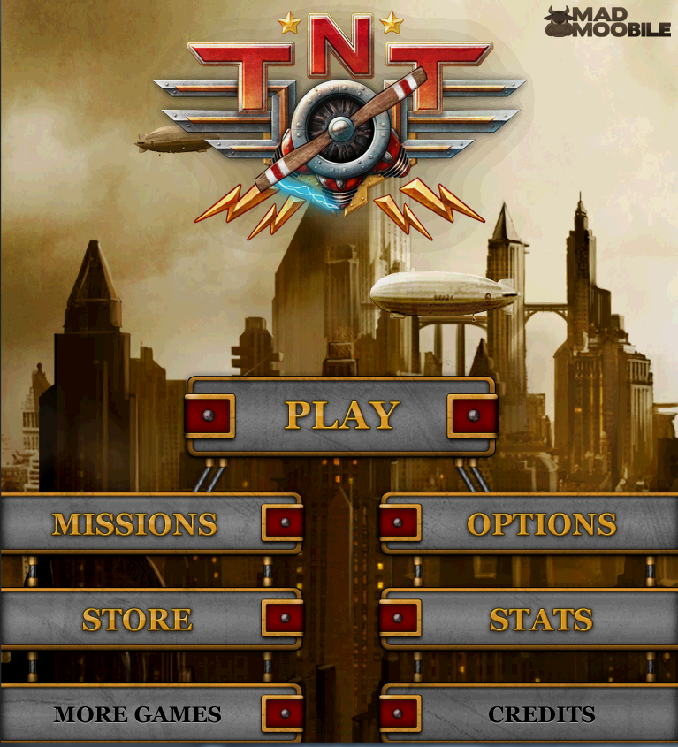
Twist & Turn
Unity Physics
Early Unity UI
Unity Input/Touch

Slide 6
Unity 3D Course
Lection 1.Unity Basics

Slide 7
What is Unity 3D ?
Lection 1.Unity Basics
Multi - Platform Game Engine
Supported Languages – C#, JS, Boo
Mono
http://unity3d.com/
Notes:
Mono - An open source, cross-platform, implementation of C# and the CLR that is binary compatible with Microsoft.NET

Slide 8
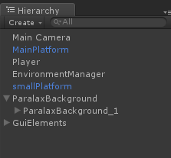
World position and coordinate system
Lection 1.Unity Basics
Cartesian coordinate system(Vector 3)
Local and world position(child/ parent)
Rotation(Euler/ Quaternion)

Slide 9
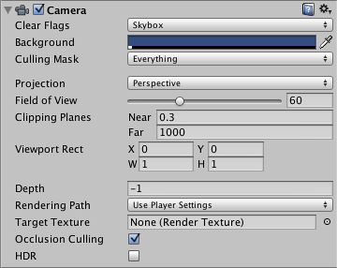
Cameras
Lection 1.Unity Basics
Define what player sees
Properties
Multiple cameras
Notes:
http://docs.unity3d.com/Manual/class-Camera.html
Explain every property
Explain GUI techniques for miltiple cameras

Slide 10
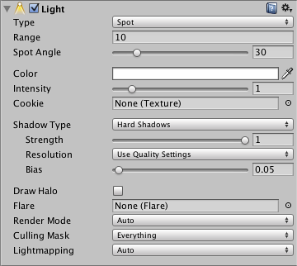
Lights & Shadows
Lection 1.Unity Basics
Lights types
Shadows types
Performance/Baking
Quality Settings
Notes:
http://docs.unity3d.com/Manual/class-Light.html
Directional lights are placed infinitely far away and affect everything in the scene, like the sun.
Point lights shine from a location equally in all directions, like a light bulb.
Spot lights shine from a point in a direction and only illuminate objects within a cone - like the headlights of a car.
Area lights (only available for lightmap baking) shine in all directions to one side of a rectangular section of a plane.
http://docs.unity3d.com/Manual/Shadows.html
http://docs.unity3d.com/Manual/class-QualitySettings.html

Slide 11
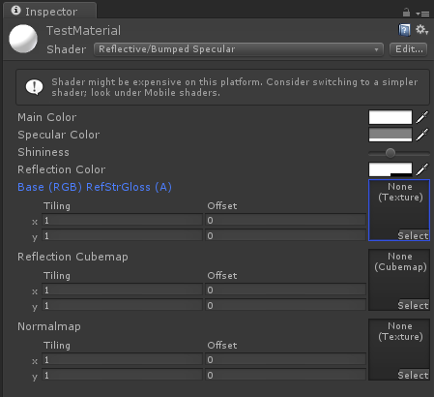
Shaders and Materials
Lection 1.Unity Basics
Shaders
Materials
Notes:
http://docs.unity3d.com/Manual/SL-Reference.html
http://docs.unity3d.com/Manual/Materials.html

Slide 12
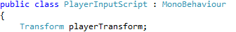
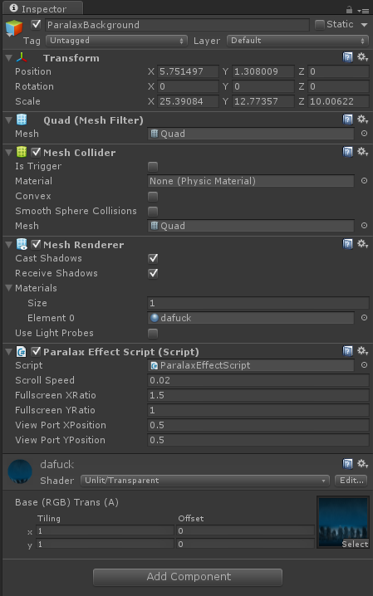
GameObjects and Components
Lection 1.Unity Basics
What is GameObject
MonoBehaviour
Components
Notes:
Explain briefly without any scripting included.
GameObject is container for different components. By attaching scrip component you define GameObject behavior
MonoBehaviour is a base class from which every gameobject script inherit. It has instance and static methods to control the behavior.

Slide 13
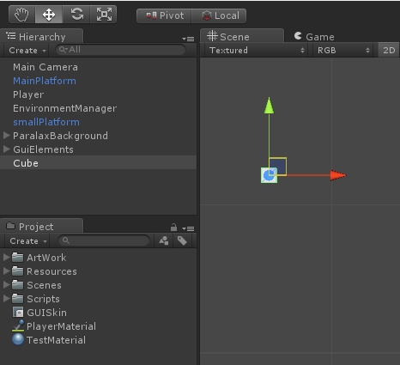
Scene, Hierarchy and Assets
Lection 1.Unity Basics
Parent/Child relation
Scene hierarchy
Assets hierarchy
Notes:
Show also scale and move dependencies when there is parent/child relation.
Show how to change pivot point of an object.
Show how to point an animation into the right direction using parent.

Slide 14
Interface
Lection 1.Unity Basics
Scene
Game
Inspector
Hierarchy
Project
Console
Animation
Animator
Asset Store
Notes:
Explain every window briefly

Slide 15
MonoBehaviour Basics
Lection 1.Unity Basics
FixedUpdate , Update, LateUpdate
Awake, Start
OnEnable, OnDisable
Notes:
Awake is called first even the script component is not enabled.
Start is called only if script component is enabled.
Awake and start are called only once in a lifetime. You can’t disable and enable and expect start and awake to be repeatedly called.
Update() vs FixedUpdate()
LateUpdate is called after all Update functions have been called. This is useful to order script execution. For example a follow camera should always be implemented in LateUpdate because it tracks objects that might have moved inside Update.

Slide 16
MonoBehaviour Basics
Lection 1.Unity Basics
Transform
Translate, Rotate
Activate/ Deactivate GameObject
Destroy
Input.GetKey()

Slide 17
Your first game! (lab part)
Lection 1.Unity Basics

Slide 18
Useful links
Lection 1.Unity Basics
http://docs.unity3d.com/Manual/
http://docs.unity3d.com/ScriptReference/
http://unity3d.com/learn/tutorials/modules

